Slide 1
Decision tree for predictive modeling
Harnessing Data for Customer Satisfaction and Sales Prediction in Retail

Slide 2
Data Exploration
Loaded the dataset using pandas and explored its structure, which includes features related to customer attributes, shopping behavior, and survey responses.
Customer satisfaction and sales prediction are crucial for retail businesses to optimize operations, improve customer experience, and enhance profitability.

Slide 3
Classification Task - Predicting Customer Satisfaction
Using Python libraries like scikit-learn to predict customer satisfaction.
The classifier's performance was assessed using metrics:
Accuracy Score: 1.0
Precision Score: 1.0
Recall Score: 1.0
F1 Score: 1.0

Slide 4
Regression Task - Predicting Sales
Classification predicts categories, while regression predicts continuous values like sales amounts.
Similar to the classification task, we divided the dataset into training and testing sets for training the regression model.
The regression model's performance was assessed with:
Mean Squared Error (MSE): 0.0
R-squared (R^2) Score: 1.0

Slide 5
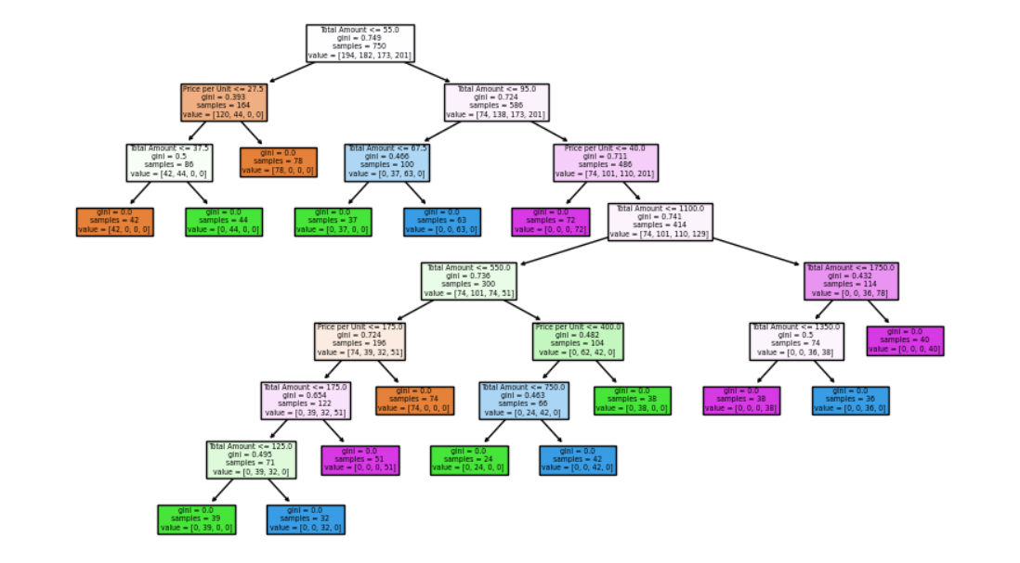
Decision Tree Visualization

Slide 6
Feature Importance
Feature importance was determined by analyzing the structure of the decision trees.
Feature importance is calculated by measuring the impact of each feature on the model's predictions, usually based on node impurity or information gain.

Slide 7
Overfitting and Pruning
Overfitting occurs when the model captures noise in the training data, leading to poor generalization.
Explored overfitting mitigation techniques, including pruning and controlling hyperparameters.
Implemented pruning, and it resulted in a slightly reduced R-squared score (0.93).

Slide 8
Real-World Application
Customer satisfaction prediction and sales forecasting are used to optimize inventory, enhance customer experience, and make informed business decisions.
The benefits include increased revenue, reduced costs, and better resource allocation.

Slide 9
Model Comparison
Compared the performance of both models, showcasing their different use cases.
Decision trees offer interpretability but may struggle with complex relationships, which may require alternative models.

Slide 10
Presentation and Recommendations
Our analysis, results, and provided recommendations for the retail business.
Predictive modeling provides actionable insights, enabling data-driven decision-making in the retail industry.

Slide 11

Q&A

Slide 12

Thank you

